Slide 1
Student Attendance Management System
Srilakshmi Bhukya
Axis10JFSB1001

Slide 2
Introduction
Attendance Management System is a web based application designed for managing attendance of students in a school. It facilitates teachers to easily record attendance and calculate percentage of students for find their the eligibility criteria.
It is time efficient
It reduces paperwork
Cost reduction
Reduces manual work

Slide 3

Traditional system
Costly
Paper usage is more
Need to spend more time
Changes can’t be done easily

Slide 4
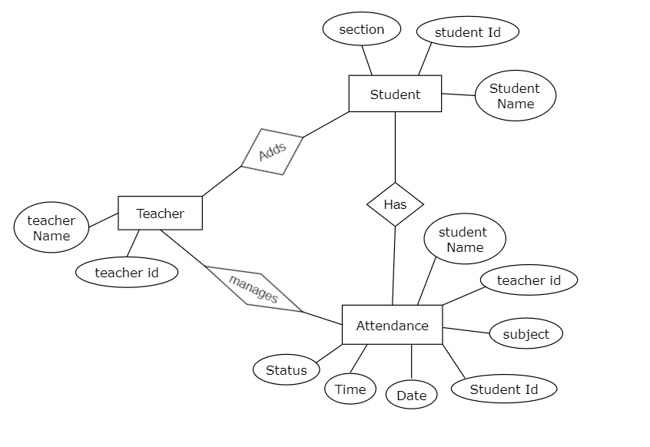
ER Diagram

Slide 5
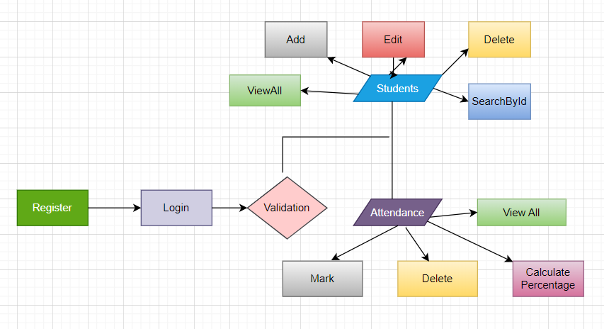
How it Works ?

Slide 6
Data Required
Teacher credentials for logging
Students details for marking attendance
Attendance records for calculating percentage
Formula for calculating percentage:
%= no of days present*100 / total no of days

Slide 7







Tools Used

Slide 8
Thank You !

